Slide 1
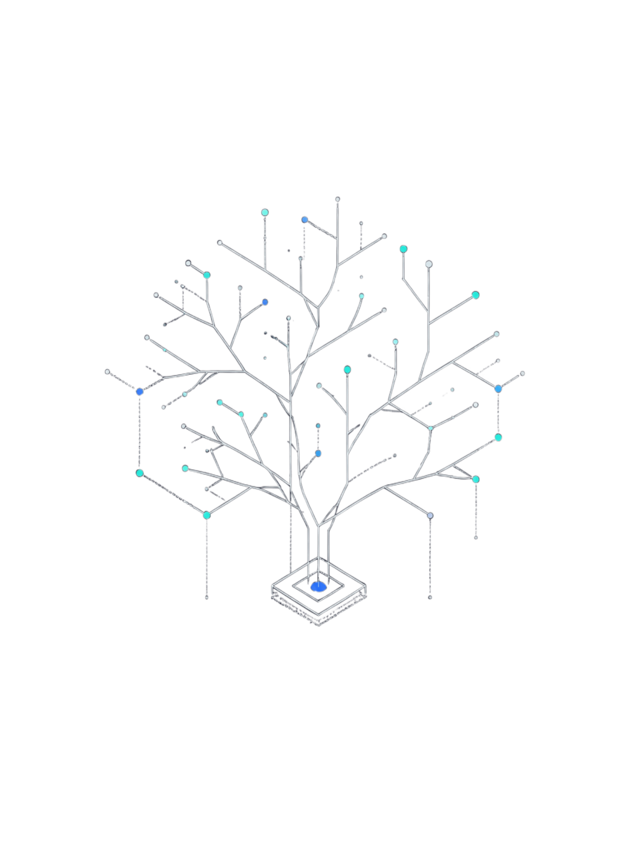
Recursion Tree Method: Solving T(n) = 3T(n/2) + n
A visual approach to analyzing divide-and-conquer recurrences in Computer Science.
NAME:- N.Thanveer basha
REG.NO:-192372122
COURSE CODE :- CSA0612
COURSE NAME:- DESIGN AND ANLYSIS OF ALGORITHM

Slide 2
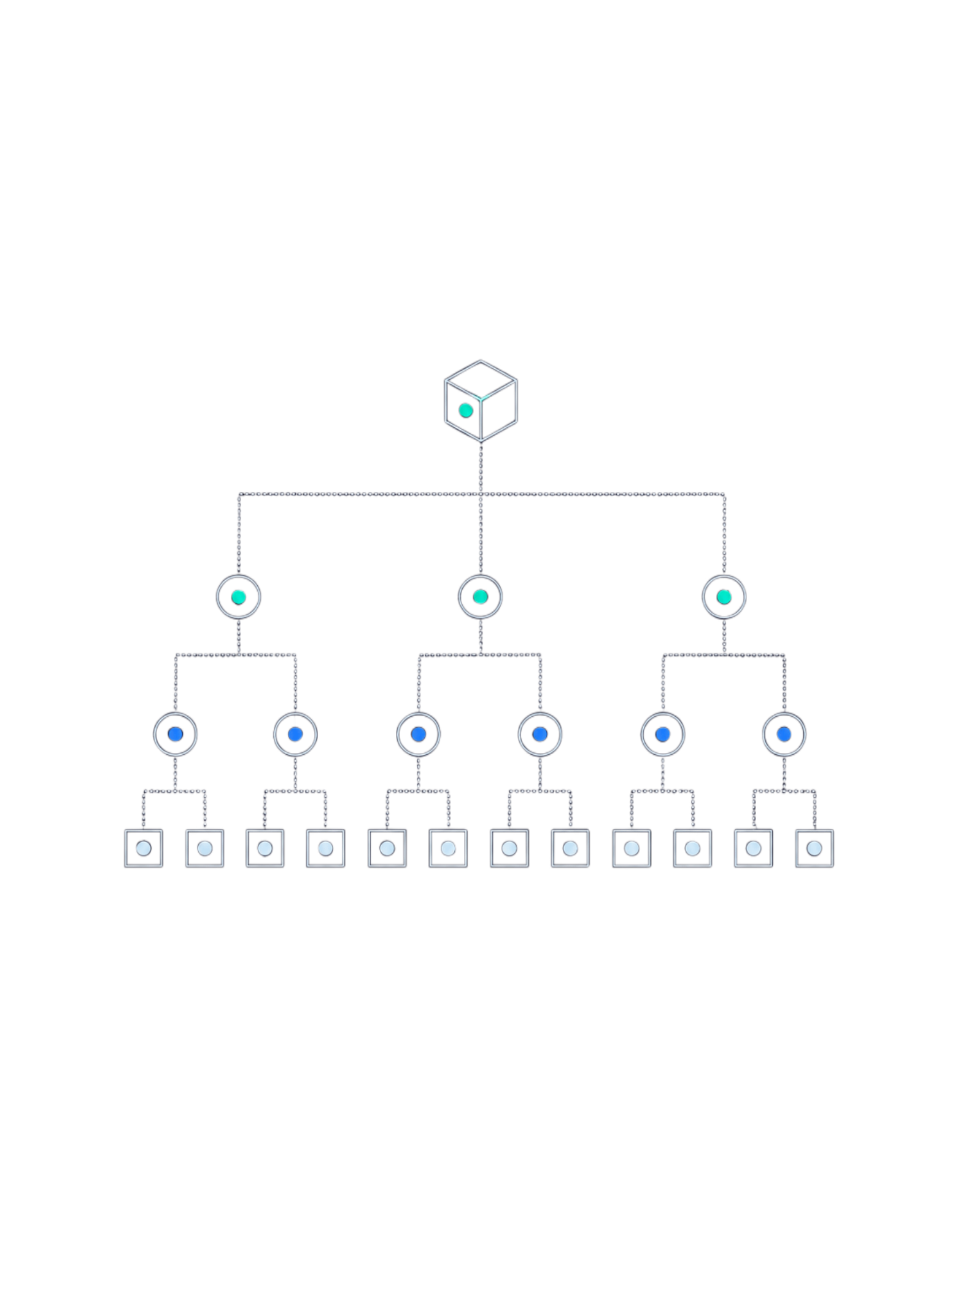
What is the Recursion Tree Method?
Definition
A visual technique to solve recurrences by expanding recursive calls into a tree structure, making cost accumulation explicit at every level.
Goal
Sum the cost at every level of the tree to derive the total running time of the recurrence.
Best Used For
Recurrences of the form T(n) = aT(n/b) + f(n), where a ≥ 1, b > 1 — the classic divide-and-conquer shape.
Our Recurrence
T(n) = 3T(n/2) + n — branching factor 3, subproblem size halved at each level.

Slide 3
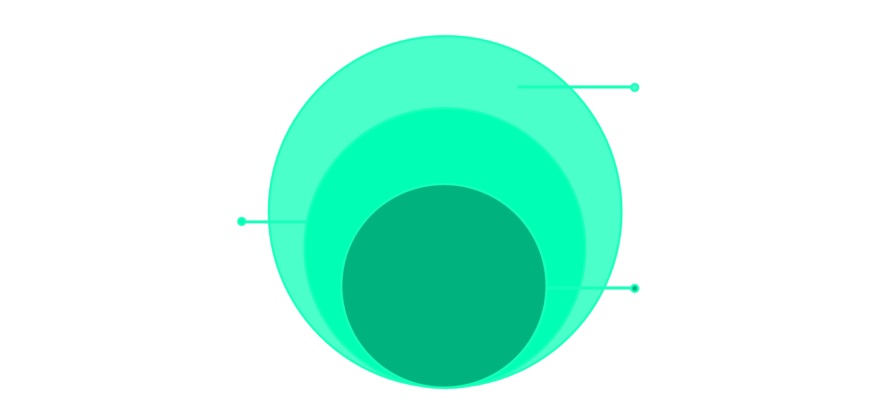
Structure of the Recursion Tree
Leaves
Level log₂n: T(1) leaves
Level 1
3 nodes n/2 each
Level 0
Root n (cost n)
Root (Level 0)
Branching Factor
Tree Height
Leaf Count
Problem of size n, cost = n
Each node spawns 3 children; subproblem size at level i is n/2ⁱ
Recursion stops when n/2ⁱ = 1 → height = log₂n levels
At depth log₂n: 3^(log₂n) = n^(log₂3) leaves

Slide 4

Cost at Each Level
Key Insight
Level (i)
Nodes
Cost per Node
Total Cost at Level
Each level's cost grows by a factor of 3/2 compared to the level above.
This makes the tree cost-increasing from top to bottom — the deeper you go, the more total work is done at that level.
0
1
n
n
1
3
n/2
(3/2)n
2
9
n/4
(3/2)²n
i
3ⁱ
n/2ⁱ
(3/2)ⁱ · n
The ratio 3/2 > 1 tells us immediately that leaf cost will dominate the total.
log₂n
n^log₂3
Θ(1)
Θ(n^log₂3)

Slide 5
Total Cost Derivation
01
02
Sum Over All Levels
Apply Geometric Series Formula
T(n) = Σᵢ₌₀^(log₂n − 1) (3/2)ⁱ · n + Θ(n^log₂3)
Σ (3/2)ⁱ = [(3/2)^(log₂n) − 1] / (3/2 − 1) = 2[(3/2)^(log₂n) − 1]
03
04
Simplify the Exponent
Combine and Conclude
(3/2)^(log₂n) = n^(log₂(3/2)) = n^(log₂3 − 1)
Internal node cost = O(n · n^(log₂3 − 1)) = O(n^log₂3), which is dominated by leaf cost Θ(n^log₂3).

Slide 6
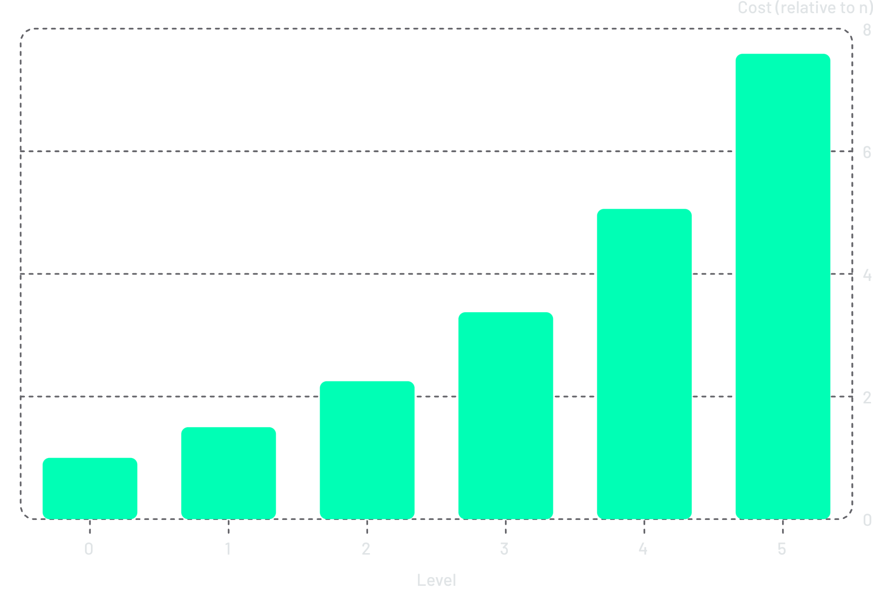
Final Result: T(n) = Θ(n^log₂3)
Interpreting the Result
log₂3 ≈ 1.585, so T(n) = Θ(n^1.585).
Leaf cost dominates: The cost grows geometrically — most work is done at the deepest levels of the tree.
Super-linear but sub-quadratic: The algorithm is strictly better than O(n²) and strictly worse than O(n log n).
Geometric ratio 3/2 > 1 is the decisive factor — it drives all work toward the leaves.

Slide 7
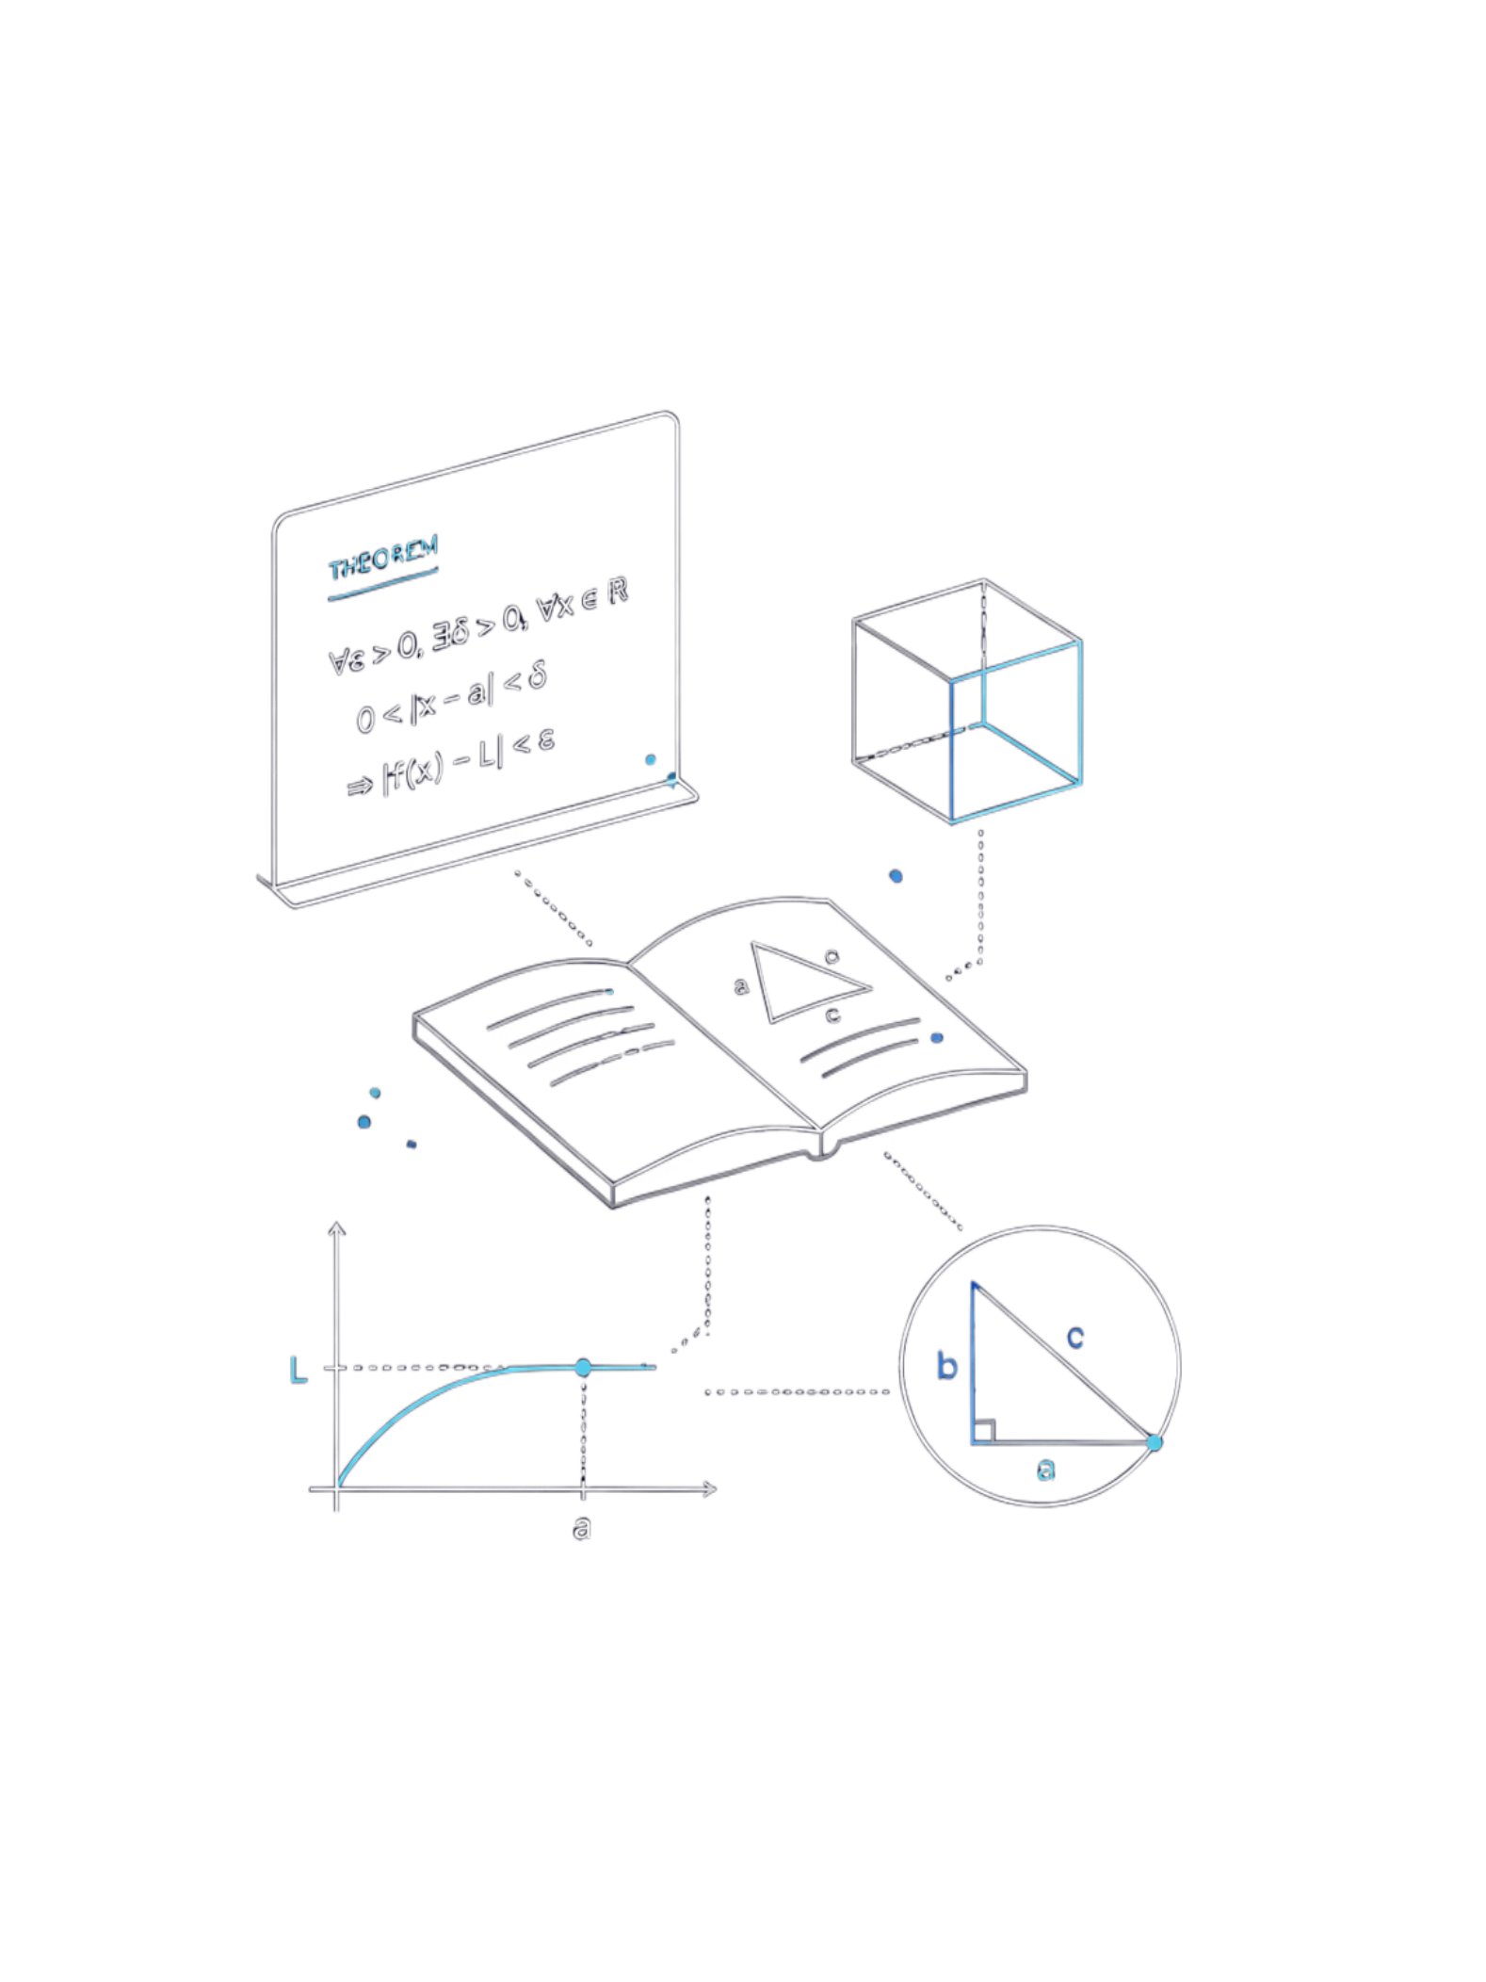




Verification via Master Theorem
Identify Parameters
T(n) = 3T(n/2) + n
a = 3, b = 2, f(n) = n
Compute Critical Exponent
log_b(a) = log₂3
≈ 1.585
Compare f(n) vs n^log₂3
f(n) = n = O(n¹)
Since 1 < 1.585, f(n) = O(n^(log₂3 − ε)) for ε ≈ 0.585
Case 1 Applies ✓
T(n) = Θ(n^log₂3)
Confirms the recursion tree result exactly.

Slide 8

Key Takeaways
Recursion Tree Method
Provides intuitive, visual insight into how costs accumulate across levels of a divide-and-conquer algorithm.
Geometric Growth (ratio > 1)
When the per-level cost ratio exceeds 1, leaf cost dominates and T(n) = Θ(n^log_b(a)).
Master Theorem
A fast algebraic shortcut — the recursion tree is the rigorous proof behind it, revealing why each case holds.
Confirmed Result
For T(n) = 3T(n/2) + n, both methods confirm T(n) = Θ(n^log₂3) ≈ Θ(n^1.585).

Slide 9


